Slide 1
ALL YOU NEED TO KNOW ABOUT RISK FACTORS
Author: Ph.D.Stefan Kovacs
E-mail:safetyinknowledge@gmail.com

Slide 2
DISCLAIMER
The content of this presentation was designed in order to give the most important informations regarding occupational risk factors. Part of this content is derived from Internet public sources with free access. We have looked upon this material, made the necessary corrections (where in case) and use it in the spirit of the improvement of safety education and of reduction of loss, incidents and accidents.

Slide 3
COURSE OBJECTIVE
Occupational Risk is unseparable by any economic activity. Occupational Risk is manifesting through specific risk factors. Occupational Risk could lead to loss, incidents and occupational accidents if not properly managed.
This course is presenting the role of occupational risk factors in defining risk and also the main occupational risk factors that could affect your activity and also your outputs . Examples and case studies are given so that the understanding could be more optimal and efficent.

Slide 4
HAZARD AND RISK
The terminology used in OSH varies between countries, but generally speaking:
A hazard is something that can cause harm if not controlled. The outcome is the harm that results from an uncontrolled hazard.
A risk is a combination of the probability that a particular outcome will occur and the severity of the harm involved.

Slide 5
WHAT IS HAZARD ?
A hazard is any source of potential damage, harm or adverse health effects on something or someone under certain conditions at work.
Basically, a hazard can cause harm or adverse effects (to individuals as health effects or to organizations as property or equipment losses).
Hazard is a generic notion.
Sometimes a hazard is referred to as being the actual harm or the health effect it caused rather than the hazard. For example, the disease tuberculosis (TB) might be called a hazard by some but in general the TB-causing bacteria would be considered the "hazard" or "hazardous biological agent".

Slide 6
HAZARD EXAMPLES

Slide 7
HAZARD AND RISK
RISK IS A QUANTIFIED HAZARD
Hazard->Hazard specific caracteristics->Risk factors->Risk
Operationally the notion of risk is much more used. Hazards are considered as an academic notion.

Slide 8
HAZARD AND RISK
Example: A worker is required at his workplace to currently handle manually heavy loads of more than 50 kg each. The outcome could be a musculoskeletal disorder (MSD) or an acute back or joint injury. The risk for the employee that would be hired to do such activity is 3.5 on a 1 to 5 scale where 5 is maximum.

Slide 9
WHAT IS RISK ?
HAZARD +GRAVITY (SEVERITY)+PROBABILITY+EXPOSURE=RISK

Slide 10
WHAT IS RISK ?
RISK=EXPOSURE x SEVERITY X GRAVITY (one possible formula).
Risk is the chance or probability that a person will be harmed or experience an adverse health effect if exposed to a hazard. It may also apply to situations with property or equipment loss.

Slide 11
RISK ASSESSMENT
Modern occupational safety and health legislation usually demands that a risk assessment be carried out prior to making an intervention. It should be kept in mind that risk management requires risk to be managed to a level which is as low as is reasonably practical (ALARP).
This assessment should:
Identify the hazards
Identify all affected by the hazard and how
Evaluate the risk
Identify and prioritize appropriate control measures.
The calculation of risk is based on the likelihood or probability of the harm being realized and the severity of the consequences.
The assessment should be recorded and reviewed periodically and whenever there is a significant change to work practices. The assessment should include practical recommendations to control the risk. Once recommended controls are implemented, the risk should be re-calculated to determine of it has been lowered to an acceptable level. Generally speaking, newly introduced controls should lower risk by one level, i.e., from high to medium or from medium to low

Slide 12
TRIAD OF INTERACTIONS
Triad of interactions
Risk factor ( severity and probability)
Environment (social context, availability of immediate care, etc)
Exposed person (host) (Exposure, individual characteristics, etc.)

Slide 13
INFLUENCING RISKS
The three Ho-Ho-Ho...:
How much a person is exposed to a hazardous thing or condition,
How the person is exposed (e.g., breathing in a vapor, skin contact), and
How severe are the effects under the conditions of exposure.

Slide 14
RISK FACTORS
RISK FACTORS are attributes associated with a specific risk.
Generally a risk factor shows:
-the way in which risk is being produced, its main elements and outcomes;
-the way in which the risk is acting upon the human body, determining accidents or occupational diseases;
-the consequences of the specific risk upon the human body;
As it can be seen- these factors are descriptive and specific to each risk.

Slide 15
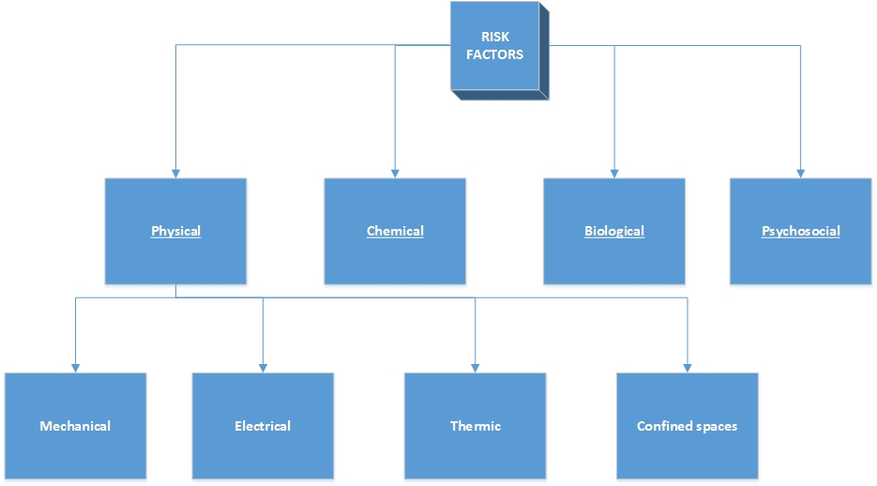
RISK FACTORS
An easy way to clasify risk factors is presented below:

Slide 16
PHYSICAL RISK FACTORS

Slide 17
RISK FACTORS-Physical
Physical hazards are a common source of injuries in many industries.They are perhaps unavoidable in certain industries, such as construction and mining, but over time people have developed safety methods and procedures to manage the risks of physical danger in the workplace. Employment of children may pose special problems.

Slide 18
RISK FACTORS-Physical
Mechanical risk factors: are represented by the mechanical impact of the employee with tools and machines that are used at workplace.
As a mechanism for interaction, generally the employee enters accidentally in the space of work with the variant that the tool is getting outside its normal ways of process (by crushing and been projected in the workspace- as an example)
The mechanical interaction with the body could result in cuts, bruises, crashes, etc.

Slide 19
RISK FACTORS-Physical
Mechanical risk factors: Many machines involve moving parts, sharp edges, hot surfaces and other hazards with the potential to crush, burn, cut, shear, stab or otherwise strike or wound workers if used unsafely. Various safety measures exist to minimize these hazards, including lockout-tag out procedures for machine maintenance and roll over protection systems for vehicles.[

Slide 20
RISK FACTORS-Physical
Mechanical risk factors:
Cutting is a compressive and shearing phenomenon, and occurs only when the total stress generated by the cutting implement exceeds the strength of the material of the object being cut. The simplest applicable equation is stress = force/area : Hence, the smaller the area (i.e., the sharper the cutting implement), the less force is needed to cut something.
Shearing refers more specifically to a mechanical process that causes a plastic shear strain in a material, rather than causing a merely elastic one. A plastic shear strain is a continuous (non-fracturing) deformation that is irreversible, such that the material does not recover its original shape. It occurs when the material is yielding. The process of shearing a material may induce a volumetric strain along with the shear strain..

Slide 21
RISK FACTORS-Physical
Mechanical risk factors:
Stabbing is penetration with a sharp or pointed object at close range. Stab connotes purposeful action but it is also possible to accidentally stab oneself or others. Stabbing differs from slashing or cutting in that the motion of the object used in a stabbing generally moves perpendicular to and directly into the victim's body, rather than being drawn across it.

Slide 22
RISK FACTORS-Physical
Mechanical risk factors:
Penetrating trauma is an injury that occurs when an object pierces the skin and enters a tissue of the body, creating an open wound. In blunt, or non-penetrating trauma, there may be an impact, but the skin is not necessarily broken. The penetrating object may remain in the tissues, come back out the way it entered, or pass through the tissues and exit from another area. An injury in which an object enters the body or a structure and passes all the way through is called a perforating injury, while penetrating trauma implies that the object does not pass through. Perforating trauma is associated with an entrance wound and an often larger exit wound.

Slide 23
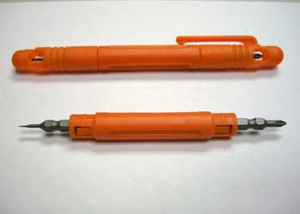
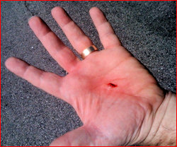
RISK FACTORS-Physical
Mechanical risk factors:
Stabbing

Slide 24
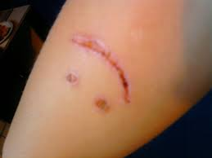
RISK FACTORS-Physical
Mechanical risk factors:
CUTTING

Slide 25
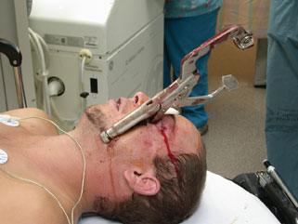
RISK FACTORS-Physical
Mechanical risk factors:
Penetrating trauma

Slide 26
RISK FACTORS-Physical
Mechanical risk factors:
Noise also presents a fairly common workplace hazard: occupational hearing loss is the most common work-related injury in the United States, with 22 million workers exposed to hazardous noise levels at work .Noise is not the only source of occupational hearing loss; exposure to chemicals such as aromatic solvents and metals including lead, arsenic, and mercury can also cause hearing loss.
Vibrating machinery can also cause work-related illness and injury

Slide 27
RISK FACTORS-Physical
Mechanical risk factors:
Noise and vibrations

Slide 28
RISK FACTORS-Physical
Electrical risks: Electricity poses a danger to many workers. Electrical injuries can be divided into four types: fatal electrocution, electric shock, burns, and falls caused by contact with electric energy

Slide 29
RISK FACTORS-Physical
Electrical risks:Electric shock is the physiological reaction or injury caused by electric current passing through the (human) body It occurs upon contact of a (human) body part with any source of electricity that causes a ssufficient current through the skin, muscles, or hair.
Very small currents can be imperceptible. Larger current passing through the body may make it impossible for a shock victim to let go of an energized object. Still larger currents can cause fibrillation of the heart and damage to tissues. Death caused by an electric shock is called electrocution.
An electrical injury has many consequences to a body as the electrical currents can travel through the nervous system and burn out tissue in patches along the way. Wiring or other metalwork which is at a hazardous voltage which can constitute a risk of electric shock is called "live", as in "live wire".
Shocks can be caused by direct or indirect contact. Contact with an exposed conductive part under fault conditions is called indirect contact.

Slide 30
RISK FACTORS-Physical
Electrical risks:Arc flash hazards
The OSHA found that up to 80 percent of its electrical injuries involve thermal burns due to arcing faults. The arc flash in an electrical fault produces the same type of light radiation from which electric welders protect themselves using face shields with dark glass, heavy leather gloves, and full-coverage clothing. The heat produced may cause severe burns, especially on unprotected flesh. The arc blast produced by vaporizing metallic components can break bones and damage internal organs. The degree of hazard present at a particular location can be determined by a detailed analysis of the electrical system, and appropriate protection worn if the electrical work must be performed with the electricity on.

Slide 31
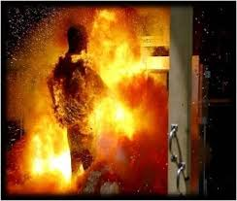
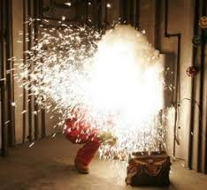
RISK FACTORS-Physical
Electrical risks:
Arc-flash

Slide 32
RISK FACTORS-Physical
Electrical risks: Symptoms
Burns-Heating due to resistance can cause extensive and deep burns. Voltage levels of 500 to 1000 volts tend to cause internal burns due to the large energy (which is proportional to the duration multiplied by the square of the voltage divided by resistance) available from the source. Damage due to current is through tissue heating. For most cases of high-energy electrical trauma, the Joule heating in the deeper tissues along the extremity will reach damaging temperatures in a few seconds.
Ventricular fibrillation-A domestic power supply voltage (110 or 230 V), 50 or 60 Hz alternating current (AC) through the chest for a fraction of a second may induce ventricular fibrillation at currents as low as 30 mA.[6] With direct current (DC), 300 to 500 mA is required.[7] If the current has a direct pathway to the heart (e.g., via a cardiac catheter or other kind of electrode), a much lower current of less than 1 mA (AC or DC) can cause fibrillation. If not immediately treated by defibrillation, fibrillation is usually lethal because all of the heart muscle cells move independently instead of in the coordinated pulses needed to pump blood and maintain circulation. Above 200 mA, muscle contractions are so strong that the heart muscles cannot move at all, but these conditions prevent fibrillation.

Slide 33
RISK FACTORS-Physical
Electrical risks: Symptoms
Neurological effects-Current can cause interference with nervous control, especially over the heart and lungs. Repeated or severe electric shock which does not lead to death has been shown to cause neuropathy. Recent research has found that functional differences in neural activation during spatial working memory and implicit learning oculomotor tasks have been identified in electrical shock victims. When the current path is through the head, it appears that, with sufficient current applied, loss of consciousness almost always occurs swiftly. (This is borne out by some limited self-experimentation by early designers of the electric chair[citation needed] and by research from the field of animal husbandry, where electric stunning has been extensively studied)

Slide 34
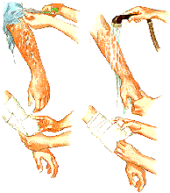
RISK FACTORS-Physical
Electrical risks:
Burns produced by electricity

Slide 35
RISK FACTORS-Physical
Thermic risks: Temperature extremes can also pose a danger to workers. Heat stress can cause heat stroke, exhaustion, cramps, and rashes. Heat can also fog up safety glasses or cause sweaty palms or dizziness, all of which increase the risk of other injuries. Workers near hot surfaces or steam also are at risk for burns.Dehydration may also result from overexposure to heat. Cold stress also poses a danger to many workers. Overexposure to cold conditions or extreme cold can lead to hypothermia, frostbite, trench foot, or chilblains.

Slide 36
RISK FACTORS-Physical
Thermic risks:HSE gives six factors for thermal confort:
Air temperature:This is the temperature of the air surrounding the body. It is usually given in degrees Celsius (°C) or degrees Fahrenheit (°F).
Radiant temperature:Thermal radiation is the heat that radiates from a warm object. Radiant heat may be present if there are heat sources in an environment. Radiant temperature has a greater influence than air temperature on how we lose or gain heat to the environment. Our skin absorbs almost as much radiant energy as a matt black object, although this may be reduced by wearing reflective clothing. Examples of radiant heat sources include: the sun; fire; electric fires; furnaces; steam rollers; ovens; walls in kilns; cookers; dryers; hot surfaces and machinery, molten metals etc.

Slide 37
RISK FACTORS-Physical
Thermic risks:HSE gives six factors for thermal confort:
Air velocity :This describes the speed of air moving across the worker and may help cool the worker if it is cooler than the environment. Air velocity is an important factor in thermal comfort because people are sensitive to it. Still or stagnant air in indoor environments that are artificially heated may cause people to feel stuffy. It may also lead to a build-up in odor. Moving air in warm or humid conditions can increase heat loss through convection without any change in air temperature. Small air movement in cool or cold environments may be perceived as draught. If the air temperature is less than skin temperature it will significantly increase convective heat loss. Physical activity also increases air movement, so air velocity may be corrected to account for a person's level of physical activity.
Humidity: if water is heated and it evaporates to the surrounding environment, the resulting amount of water in the air will provide humidity. Relative humidity is the ratio between the actual amount of water vapor in the air and the maximum amount of water vapor that the air can hold at that air temperature. Relative humidity between 40% and 70% does not have a major impact on thermal comfort. In some offices, humidity is usually kept between 40-70% because of computers. However, in workplaces which are not air conditioned, or where the climatic conditions outdoors may influence the indoor thermal environment, relative humidity may be higher than 70% on warm or hot humid days. Humidity in indoor environments can vary greatly, and may be dependent on whether there are drying processes (paper mills, laundry etc.) where steam is given off.

Slide 38
RISK FACTORS-Physical
Thermic risks:HSE gives six factors for thermal confort:
Clothing insulation : Clothing, by its very nature, interferes with our ability to lose heat to the environment. Thermal comfort is very much dependent on the insulating effect of clothing on the wearer. Wearing too much clothing or personal protective equipment (PPE) may be a primary cause of heat stress even if the environment is not considered warm or hot. If clothing does not provide enough insulation, the wearer may be at risk from cold injuries such as frost bite or hypothermia in cold conditions. Clothing is both a potential cause of thermal discomfort as well as a control for it as we adapt to the climate in which we live and play. You may add layers of clothing if you feel cold, or remove layers of clothing if you feel warm. However, many companies remove this ability for their employees to make reasonable adaptations to their clothing. It is important to identify how the clothing may contribute to thermal comfort or discomfort. It may also be necessary to evaluate the level of protection that any PPE is providing – can less or other PPE be used?
Work rate/metabolic heat :The work or metabolic rate, is essential for a thermal risk assessment. It describes the heat that we produce inside our bodies as we carry out physical activity. The more physical work we do, the more heat we produce. The more heat we produce, the more heat needs to be lost so we don’t overheat. The impact of metabolic rate on thermal comfort is critical. When considering these factors, it is also essential to consider a person's own physical characteristics.

Slide 39
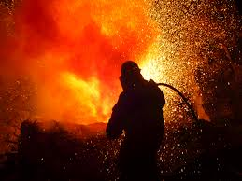
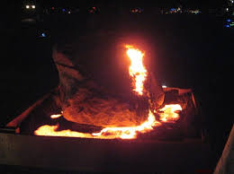
RISK FACTORS-Physical
Thermic risks:
Thermic risks

Slide 40
RISK FACTORS-Physical
Confined spaces: Confined spaces also present a physical work hazard. The National Institute of Occupational Safety and Health defines "confined space" as having limited openings for entry and exit and unfavorable natural ventilation, and which is not intended for continuous employee occupancy. Spaces of this kind can include storage tanks, ship compartments, sewers, and pipelines.Confined spaces can pose a hazard not just to workers, but also to people who try to rescue them.

Slide 41
RISK FACTORS-Physical
Confined spaces: A confined space is an enclosed area with limited space and accessibility. An example is the interior of a storage tank, which may be occasionally entered by workers for maintenance but is otherwise not a habitable space. Hazards in a confined space often include harmful dust or gases, asphyxiation, submersion in liquids or free-flowing granular solids (for example, grain bins), electrocution, or entrapment. Confined space accidents are of particular concern in occupational safety and health due to the hazards that they pose to the victim and subsequently to a rescue team. Confined space training outlines the skills and protocols for safe entry to confined spaces, and includes precautions such as locking and tagging out connecting piping, testing of breathable air quality, forced ventilation, observation of workers in the space, and a predetermined rescue plan with appropriate safety harnesses and other rescue equipment standing by.

Slide 42
RISK FACTORS-Physical
Confined spaces:Atmospheric hazards-The most common hazard seen in confined spaces is that of atmospheric hazards. These affect air quality and present immediate hazards to health or life. Acceptable atmospheric conditions must be verified before entry, and must be monitored continuously while the space is occupied. The oxygen concentration, the presence of toxic gases, and flammable material are the three conditions that must be monitored.
Oxygen concentration is considered safe if it is between 19.5% and 23.5% of the total atmosphere. To protect against toxic gases, contaminants have permissible exposure limits (PELs), which are set by OSHA. Work also cannot continue if the concentration of a material reaches or exceeds 10% of its lower explosive limit.
Even if a tank or similar vessel initially is tested and found to contain breathable air, a hazard can develop during operations inside the tank if residues inside the tank can release toxic gas or vapor when disturbed or if accidentally ignited. Steel water tanks may have dangerously low oxygen concentration when the interior rusts.

Slide 43
RISK FACTORS-Physical
Confined spaces:Injuries and fatalities involving confined spaces are frequent and often involve successive fatalities when would-be rescuers succumb to the same problem as the initial victim. Approximately 60% of fatalities involve would-be rescuers and more than 30% of fatalities occur in a space that has been tested and found to be safe to enter. One example was in 2006 at the decommissioned Sullivan Mine in British Columbia, Canada when one initial victim and then three rescuers all died.
Accidents in confined spaces present unique challenges and are often catastrophic, such as the Xcel Energy Cabin Creek Fire in 2007.

Slide 44
RISK FACTORS-Physical
Confined space case study- Xcel Energy Cabin Creek Fire - Firefighters who first arrived at the scene desperately tried to rescue the workers by taking a small gas-powered all-terrain vehicle through the entrance and up the tunnel, but they were turned back by thick smoke. A rescue would have involved firefighters using ropes or ladders to go down a 20-foot vertical section of tunnel, then down a 1,000-foot section sloped 55 degrees to reach a horizontal section where the workers were.
The workers had just finished sandblasting the inside of a portion of the tunnel that serves as a pipe from a mountain reservoir to a hydroelectric generator. They began spraying epoxy paint inside the tunnel and were having problems keeping the mixture flowing through the hoses. They painted about 10 feet of the tunnel and had stopped for the day.
While cleaning their spraying equipment with a flammable solvent, a static spark from machinery inside the tunnel likely ignited the fire, according to the report.
The five trapped workers communicated via radio for 45 minutes with colleagues and rescue crews.

Slide 45
RISK FACTORS-Physical
Confined spaces:
Confined spaces

Slide 46
BIOLOGICAL RISK FACTORS

Slide 47
RISK FACTORS-Biological
As part of Community Strategy for 2002–2006, a survey carried out by the European Risk Observatory of the European Agency for Safety and Health at Work has in fact identified the following ten emerging biological risks :
1) occupational risks related to global epidemics;
2) difficult assessment of biological risks;
3) workers exposure to drug-resistant microorganisms;
4) lack of information on biological risks;
5) poor maintenance of air-conditioning and water systems;
6) inadequate OSH (Occupational Safety Health) training of local authorities staff;
7) biohazards in waste treatment plants;
8) combined exposure to bio aerosols and chemicals;
9) endotoxins;
10) molds in indoor workplaces.

Slide 48
RISK FACTORS-Biological
Biological hazards (biological risk factors) , also known as biohazards, refer to biological substances that pose a threat to the health of living organisms, primarily that of humans. This can include medical waste or samples of a microorganism, virus or toxin (from a biological source) that can affect human health. It can also include substances harmful to other animals.
The term and its associated symbol are generally used as a warning, so that those potentially exposed to the substances will know to take precautions. The biohazard symbol was developed in 1966 by Charles Baldwin, an environmental-health engineer working for the Dow Chemical Company on the containment products.[

Slide 49
RISK FACTORS-Biological
Exposure to biological agents can occur by contact of skin and mucous membranes with many matrices. At work, this contact is with natural or organic materials (e.g., soil, plant materials), organic dust (e.g., flour, paper), substances of animal origin, food, waste, wastewater and body fluids. Many working activities are involved by biological risk. Biological risk can be found in traditional work environments, such as agriculture, but also in workplaces with modern technologies, such as biotechnology industry, and the exposure can also be accidental.

Slide 50
RISK FACTORS-Biological
Bio-hazardous agents are classified as:
Category A, UN 2814- Infectious substances affecting humans and animals: An infectious substance in a form capable of causing permanent disability or life-threatening or fatal disease in otherwise healthy humans or animals when exposure to it occurs.
Category B, UN 2900- Infectious substances affecting animals only: An infectious substance that is not in a form generally capable of causing permanent disability of life-threatening or fatal disease in otherwise healthy humans and animals when exposure to themselves occurs.
Category C, UN 3373- Biological substance transported for diagnostic or investigative purposes.
Regulated Medical Waste, UN 3291- Waste or reusable material derived from medical treatment of an animal or human, or from biomedical research, which includes the production and testing of biological products.

Slide 51
RISK FACTORS-Biological
Biohazard Level 1: Bacteria and viruses including Bacillus subtilis, canine hepatitis, Escherichia coli, varicella (chicken pox), as well as some cell cultures and non-infectious bacteria. At this level precautions against the bio hazardous materials in question are minimal, most likely involving gloves and some sort of facial protection.

Slide 52
RISK FACTORS-Biological
Biohazard Level 2: Bacteria and viruses that cause only mild disease to humans, or are difficult to contract via aerosol in a lab setting, such as hepatitis A, B, and C, influenza A, Lyme disease, salmonella, mumps, measles, scrape, dengue fever, HIV. Routine diagnostic work with clinical specimens can be done safely at Biosafety Level 2, using Biosafety Level 2 practices and procedures. Research work (including co-cultivation, virus replication studies, or manipulations involving concentrated virus) can be done in a BSL-2 (P2) facility, using BSL-3 practices and procedures.

Slide 53
RISK FACTORS-Biological
Biohazard Level 3: Bacteria and viruses that can cause severe to fatal disease in humans, but for which vaccines or other treatments exist, such as anthrax, West Nile virus, Venezuelan equine encephalitis, SARS virus, tuberculosis, typhus, Rift Valley fever, Rocky Mountain spotted fever, yellow fever, and malaria. Among parasites Plasmodium falciparum, which causes Malaria, and Trypanosome cruzi, which causes trypanosomiasis, also come under this level.

Slide 54
RISK FACTORS-Biological
Biohazard Level 4: Viruses and bacteria that cause severe to fatal disease in humans, and for which vaccines or other treatments are not available, such as Bolivian and Argentine hemorrhagic fevers, Marburg virus, Ebola virus, Middle Eastern Respiratory Syndrome (MERS) or known as (Corona Virus or CoV) hantaviruses, Lassa fever virus, Crimean–Congo hemorrhagic fever, and other hemorrhagic diseases. Variola virus (smallpox) is an agent that is worked with at BSL-4 despite the existence of a vaccine. When dealing with biological hazards at this level the use of a positive pressure personnel suit, with a segregated air supply, is mandatory. The entrance and exit of a Level Four bio lab will contain multiple showers, a vacuum room, an ultraviolet light room, autonomous detection system, and other safety precautions designed to destroy all traces of the biohazard. Multiple airlocks are employed and are electronically secured to prevent both doors opening at the same time. All air and water service going to and coming from a Biosafety Level 4 (P4) lab will undergo similar decontamination procedures to eliminate the possibility of an accidental release.

Slide 55
RISK FACTORS-Biological
Bacteria (Listeni/bækˈtɪəriə/; singular: bacterium) constitute a large domain of prokaryotic microorganisms. Typically a few micrometers in length, bacteria have a number of shapes, ranging from spheres to rods and spirals. Bacteria were among the first life forms to appear on Earth, and are present in most of its habitats. Bacteria inhabit soil, water, acidic hot springs, radioactive waste, and the deep portions of Earth's crust. Bacteria also live in symbiotic and parasitic relationships with plants and animals. They are also known to have flourished in manned spacecraft. The vast majority of the bacteria in the body are rendered harmless by the protective effects of the immune system, and some are beneficial. However, several species of bacteria are pathogenic and cause infectious diseases, including cholera, syphilis, anthrax, leprosy, and bubonic plague. The most common fatal bacterial diseases are respiratory infections, with tuberculosis alone killing about 2 million people per year,

Slide 56
RISK FACTORS-Biological
"Bacterial morphology diagram" by Mariana Ruiz

Slide 57
RISK FACTORS-Biological
Virus-virus is a small infectious agent that replicates only inside the living cells of other organisms. Viruses can infect all types of life forms, from animals and plants to microorganisms, including bacteria and archaea.Viruses are found in almost every ecosystem on Earth and are the most abundant type of biological entity. The study of viruses is known as virology, a sub-specialty of microbiology.
Virus particles (known as virions) consist of two or three parts: i) the genetic material made from either DNA or RNA, long molecules that carry genetic information; ii) a protein coat that protects these genes; and in some cases iii) an envelope of lipids that surrounds the protein coat when they are outside a cell. The shapes of viruses range from simple helical and icosahedral forms to more complex structures. Viruses spread in many ways; viruses in plants are often transmitted from plant to plant by insects that feed on plant sap, such as aphids; viruses in animals can be carried by blood-sucking insects. These disease-bearing organisms are known as vectors. Influenza viruses are spread by coughing and sneezing. Norovirus and rotavirus, common causes of viral gastroenteritis, are transmitted by the fecal–oral route and are passed from person to person by contact, entering the body in food or water. HIV is one of several viruses transmitted through sexual contact and by exposure to infected blood. The range of host cells that a virus can infect is called its "host range". This can be narrow or, as when a virus is capable of infecting many species, broad.

Slide 58
RISK FACTORS-Biological
Virus as a risk factor- By age 2, most children will have been infected with respiratory syncytial virus. Children who attend child care centers or who have siblings who attend school are at a higher risk of exposure..
People at increased risk of severe — sometimes life-threatening — infections include:
Infants younger than 6 months of age
Younger children, especially under 1 year of age, who were born prematurely or who have an underlying condition, such as congenital heart or lung disease
Children with weakened immune systems, such as those undergoing chemotherapy or transplantation
Infants in crowded child care settings
Older adults
Adults with asthma, congestive heart failure or chronic obstructive pulmonary disease
People with immunodeficiency, including those with certain transplanted organs, leukemia or HIV/AIDS

Slide 59
RISK FACTORS-Biological
A fungus (/ˈfʌŋɡəs/; plural: fungi or funguses) is any member of a large group of eukaryotic organisms that includes microorganisms such as yeasts and molds (British English: molds), as well as the more familiar mushrooms. These organisms are classified as Fungi, which is separate from plants, animals, protists, and bacteria. Fungi can break down manufactured materials and buildings, and become significant pathogens of humans and other animals. Losses of crops due to fungal diseases (e.g., rice blast disease) or food spoilage can have a large impact on human food supplies and local economies.

Slide 60
RISK FACTORS-Biological
Antibiotic Use & Fungal Infections
Antibiotics are medicines designed to kill harmful bacteria that are causing infection or illness. Sometimes these drugs can also reduce the helpful bacteria that live in the body. When these populations are reduced, fungi may take the opportunity to colonize.
Corticosteroid Use & Fungal Infections
Corticosteroids are a group of drugs that reduce inflammation. They effectively treat many skin disorders. Unfortunately, these drugs also can reduce our immune response and improve conditions for fungus growth.
Medical Conditions & Fungal Infections
Individuals with diabetes and some cancers, such as leukemia, are more susceptible to fungal infections than the general population.

Slide 61
RISK FACTORS-Biological
Compromised Immune System & Fungal Infections
The immune system is a set of chemical and cellular responses that attack disease-causing organisms and help prevent their growth. A number of factors can depress this system. These include chemotherapy (cancer-killing drugs) and acquired immune deficiency syndrome (AIDS).
A depressed immune system less effectively fights off all types of infection. Thus a fungus that normally would be controlled by the immune system may begin to grow.
Environmental Factors & Fungal Infections
Fungi require moisture to grow and reproduce. Fungal infections are more prevalent in warm, moist areas of the body, such as the mouth and vagina. Also, sweaty clothes and shoes can enhance fungus growth on the skin. Exposure to fungi is more frequent in communal areas with moisture, such as locker rooms and showers.

Slide 62
RISK FACTORS-Biological
Hereditary Factors & Fungal Infections
Some people seem to have a genetic predisposition toward fungal infections. They may contract infections more easily than others exposed to the same conditions. Whether this is due to differences in immune response, skin chemistry, or other factors is not known.
Transmission of Fungal Infections
Fungal infections can be passed from person to person or from objects and surfaces to a person. Also, an individual can transfer infection to other parts of the body by touching.

Slide 63
RISK FACTORS-Biological
A blood-borne disease (sometimes referred to as a Blood Borne Virus or BBV) is one that can be spread through contamination by blood and other body fluids. The most common examples are HIV, hepatitis B, hepatitis C and viral hemorrhagic fevers.
Diseases that are not usually transmitted directly by blood contact, but rather by insect or other vector, are more usefully classified as vector-borne disease, even though the causative agent can be found in blood. Vector-borne diseases include West Nile virus and malaria.
Many blood-borne diseases can also be transmitted by other means, including high-risk sexual behavior or intravenous drug use. These diseases have also been identified in sports medicine.
Since it is difficult to determine what pathogens any given blood contains, and some blood-borne diseases are lethal, standard medical practice regards all blood (and any body fluid) as potentially infectious. Blood and Body Fluid precautions are a type of infection control practice that seeks to minimize this sort of disease transmission
Blood poses the greatest threat to health in a laboratory or clinical setting due to needle stick injuries (e.g., lack of proper needle disposal techniques and/or safety syringes).

Slide 64
RISK FACTORS-Biological
There are actually many professional activities involving a biological hazard in various fields (health care, agriculture, forestry, zootechny, food, veterinary, biotechnology, treatment and waste disposal), even if infectious agents, endotoxins and ways of exposure show differences related to the type of work and way of exposure. Intentional and deliberate use of biological agents is involved in various workplaces (such as microbiological laboratories) and occupational exposure can be easily monitored and controlled. On the contrary, risk assessment is difficult in case of unintentional exposure in workplaces (such as agricultural activities) and exposure prevention and protection measures can be inappropriate

Slide 65
RISK FACTORS-Biological
Exposure to bio aerosols is considered very dangerous in workplaces. Bio aerosols contain a variety of airborne microorganisms, including molds and endotoxins, and various inflammatory and allergic diseases in exposed workers are attributed to their inhalation. Risk assessment presents many difficulties and is also influenced by the possible interaction of microorganisms with non–biological agents in working environment. Also the effects can be influenced by the interaction with other factors acting on the same target organs and mechanisms operating simultaneously are not known.

Slide 66
RISK FACTORS-Biological
Health care workers are considered at higher biological risk because they are permanently exposed to blood and body fluids. Their exposure to infectious agents is widely regarded as the most important occupational risk factor, even because of the high pprobability that accidents at work can increase the risk of exposure to infectious agents

Slide 67
RISK FACTORS-Biological
The presence of infectious agents can be a biological risk to dentists, but it can be reduced with specific mouth rinses by using 0.2% chlorhexidine gluconate for 1 min from the patient.
Small aerosols (<1 µm) during dental treatment can be considered an important occupational respiratory risk.
Gram-negative biological agents and bacterial endotoxins have also been detected in dental unit waterlines and in water flowing from high-speed hand pieces and it was suggested a potential risk of bronchial asthma in dentists

Slide 68
RISK FACTORS-Biological
Also farming and cattle-breeding are considered at significant biological risk. Microbiological analyses performed on environmental dust, sampled during corn and soybeans harvesting and in animal confinements (swine, poultry and dairy), revealed higher concentrations of fungal spores during corn and soybeans harvesting for total fungal spores, for culturable fungal spores, for culturable actinomycetes), higher concentrations of culturable bacteria in swine confinements during summer) and high production of particles between 2–10 μm formed by fungal spores

Slide 69
RISK FACTORS-Biological
Biological hazard is identified in the treatment of solid waste (especially in composting plants) and wastewater and in sewer workers. Environmental sampling in waste disposal plants shows biological agents, especially in composting areas. Mesospheric bacteria and Actinomycetes were found in composting plants ,fungal spores in waste collection and sorting and endotoxin during refuse collection. In solid waste workers, prevalence of antibodies anti HBc and anti Toxoplasma gondii has been observed.

Slide 70
CHEMICAL RISK FACTORS

Slide 71
RISK FACTORS-Chemical
Chemicals can be broken down into hazard classes and exhibit both physical and health hazards. It is important to keep in mind, that chemicals can exhibit more than one hazard or combinations of several hazards. Several factors can influence how a chemical will behave and the hazards the chemical presents, including the severity of the response:
Concentration of the chemical.
Physical state of the chemical (solid, liquid, gas).
Physical processes involved in using the chemical (cutting, grinding, heating, cooling, etc.).
Chemical processes involved in using the chemical (mixing with other chemicals, purification, distillation, etc.).
Other processes (improper storage, addition of moisture, storage in sunlight, refrigeration, etc.).

Slide 72
An approach to chemical risk assessment
1.Make an inventory of the substances used in the processes in the workplace and those generated by the process such as aerosols of blood or urine. Assess substances used at work including any new substances introduced.
2.Collect information about these substances, i.e. the harm they can do and how this can happen.
3.Assess exposure to the identified dangerous substances, looking at the type, intensity, length, frequency and occurrence of exposure to workers,
4.Rank the severity of the established risks. This list can then be used to draw up an action plan to protect workers.
Consider whether existing measures in place give adequate protection and what more should be done to reduce risks. Is it possible to get rid of the risk altogether by using a different agent or process? If the exposure is not avoidable, it should be kept to a minimum by limiting the number of exposed workers and the exposure time. The control measures must be tailored to the working process, and the workers must be well trained to follow safe working practices.
Review and revise your assessment where necessary, when there are significant changes in materials, equipment, work methods, location or people involved and if there are accidents or complaints associated with the work

Slide 73
Chemical Risk Factors- Communications
Hazard Communication Standard -29CFR 1910.1200; OSHA published in 1988, requires, chemical manufacturers or importers to evaluate the hazards of the products they supply and summarize this information on Material Safety Data Sheets (MSDS), shipping labels, and product warnings

Slide 74
Chemical Risk Factors- Communications
Employers must supply this information to their employees and provide training on the chemical hazards found in their work place. This includes training on reading hazard labels and MSDS, physical and health hazards of the chemicals, how to detect releases, the use of any required personal protective equipment (PPE), and the details of the hazard communication program.

Slide 75
RISK FACTORS-Chemical
Hazardous chemicals in the workplace are substances, mixtures and materials that can be classified according to their health and physicochemical risks and dangers.
Health hazards include skin irritants, carcinogens or respiratory sensitizers that have an adverse effect on a worker’s health as a result of direct contact with or exposure to the chemical, usually through inhalation, skin contact or ingestion.
Physicochemical hazards generally result from a substance’s physical and chemical properties, as is the case with flammable, corrosive, oxidizing or explosive substances.
A person conducting a business or undertaking has a primary duty to ensure, so far as is reasonably practicable, that the health and safety of workers and other people are not put at risk from the business’s use, handling or storage of hazardous chemicals.

Slide 76
Chemical Risk Factors- MSDS
Material Safety Data Sheets(MSDS) should exist in the enterprise and at the workplace for every substance or product used in the activity- substance or product that presents risks for the health, safety and/or environment.
Material Safety Data Sheets(MSDS) should include at last :
Suppliers name, address, phone #, date,
Chemical name, CAS # of all hazardous ingredients if it is > 1% of the product,
Physical and chemical characteristics, vp., fp.,
Physical hazards, including reactivity,
Health hazards, including signs and symptoms of exposure, medical conditions that might be aggravated by exposure,

Slide 77
Chemical Risk Factors- MSDS
Material Safety Data Sheets should include at last :
Primary routes of entry,
PELs, RELs, TLVs
Toxicity data,
Storage and handling data,
Emergency and first aid procedures,
Disposal considerations
Transportation information

Slide 78
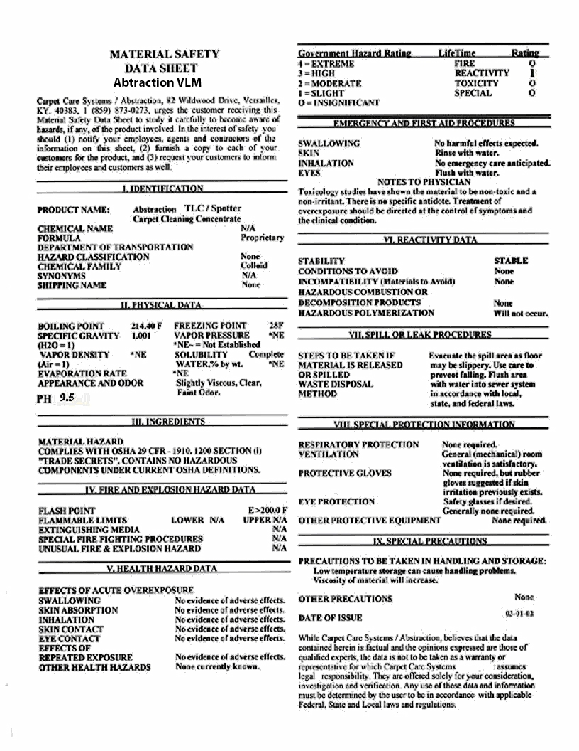
Chemical Risk Factors- MSDS

Slide 79
Chemical Risk Factors
IDENTIFICATION SYSTEM
The NFPA 704 System is a means of providing hazard information for a material. Each of the four sections is associated with a particular hazard and the higher the number the more hazardous the material is for that particular characteristic. The fourth section is to give information on special hazards. Next are the four sections and an explanation of each.

Slide 80
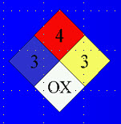
Chemical Risk Factors
RED=FLAMMABILITY
4-Materials with a flashpoint below 73 F (22 C) and a boiling point below 100 F. 3-Materials with a flashpoint below 73 F and a boiling point greater than or equal to 100 F (38 C) or a flashpoint above 73 F and less than 100 F. 2-Materials with a flashpoint above 100 F, but not exceeding 200 F (93.3 C). 1-Materials with a flashpoint above 200 F. 0-Materials which normally won't burn.

Slide 81
Chemical Risk Factors
BLUE=HEALTH HAZARD
4-Materials with an oral LD50 of less than or equal to 5 mg/kg. 3-Materials with an oral LD50 above 5, but less than 50 mg/kg. 2-Materials with an oral LD50 above 50, but less than 500 mg/kg. 1-Materials with an oral LD50 above 500, but less than 2000mg/kg.
0-Materials with an oral LD50 above 2000mg/kg

Slide 82
Chemical Risk Factors
YELLOW=REACTIVITY HAZARD
4-Material is capable of explosion or detonation at normal temperature and pressure. 3-Material is capable of explosion, but requires a strong initiating source, or the material reacts with water. 2-Material undergoes violent chemical changes at elevated temperature and pressure. 1-Normally stable, but can become unstable at elevated temperatures. 0-Normally stable.

Slide 83
Chemical Risk Factors
WHITE=SPECIAL HAZARD
W Water Reactive Ox Oxidizer COR Corrosive
Radiation

Slide 84
Chemical Risk Factors-Routes of Exposure
Inhalation - Most common route of exposure, lungs are designed for maximum transport and adsorption of vapors, large surface area (1000 sf)
Dermal – Second most common route of exposure, lipid (pass with greater ease) and water soluble chemicals can pass through the skin. Has 20 sf surface area.

Slide 85
Chemical Risk Factors-Routes of Exposure
Ingestion – can occur through food contamination, eating drinking in lab, poor hygiene, mucociliary transport of vapors trapped in upper air ways,
Injection – Can occur through injury and needle sticks

Slide 86
RISK FACTORS-Chemical
EXPLOSIVES

Slide 87
RISK FACTORS-Chemical
Explosives-The OSHA Laboratory Standard defines an explosive as a chemical that causes a sudden, almost instantaneous release of pressure, gas, and heat when subjected to sudden shock, pressure, or high temperature. Under the Department of Transportation (DOT) hazard class system, explosives are listed as hazard class 1.
Fortunately, most laboratories do not use many explosives; however, there are a number of chemicals that can become unstable and/or potentially explosive over time due to contamination with air, water, other materials such as metals, or when the chemical dries out.
If you ever come across any chemical that you suspect could be potentially shock sensitive and/or explosive, do not attempt to move the container as some of these compounds are shock, heat, and friction sensitive. In these instances, you should contact specialized help immediately.
Explosives can result in damage to surrounding materials (hoods, glassware, windows, people, etc.), generation of toxic gases, and fires. If you plan to conduct an experiment where the potential for an explosion exists, first ask yourself the question; “Is there another chemical that could be substituted in the experiment that does not have an explosion potential?”

Slide 88
RISK FACTORS-Chemical
Explosives-A probabilistic approach for explosives safety risk analysis entails calculating the product of three components to estimate annual expected fatalities (i.e. the average number of fatalities expected per year) as the basic measure of risk. The probability of an explosives event (Pe), the probability of a fatality given an event (Pf/e ), and the expected exposure of people (Ep ) are multiplied as shown in the following equation:
Ef = Pe x Pf/e x Ep
The Pe is defined as the probability that an explosives event will occur per Potential Explosion Site (PES) per year. The Pf/e is defined as the probability of fatality given an explosives event. Ep is the exposure of people to a particular PES on an annual basis.

Slide 89
RISK FACTORS-Chemical
Explosives
Decomposition-The chemical decomposition of an explosive may take years, days, hours, or a fraction of a second. The slower processes of decomposition take place in storage and are of interest only from a stability standpoint. Of more interest are the two rapid forms of decomposition, deflagration and detonation.
Deflagration-In deflagration, decomposition of the explosive material is propagated by a flame front which moves slowly through the explosive material, in contrast to detonation. Deflagration is a characteristic of low explosive material.
Detonation-This term is used to describe an explosive phenomenon whereby the decomposition is propagated by an explosive shock wave traversing the explosive material. The shock front is capable of passing through the high explosive material at great speeds, typically thousands of meters per second. It is any device or material in which the explosive is ignited thereby reaching a reactive incident.

Slide 90
RISK FACTORS-Chemical
Selection of protection measures for explosives

Slide 91
RISK FACTORS-Chemical

Slide 92
RISK FACTORS-Chemical
Flammable and Combustible Liquids

Slide 93
RISK FACTORS-Chemical
Flammable and Combustible Liquids The OSHA Laboratory Standard defines a flammable liquid as any liquid having a flashpoint below 100 degrees F (37.8 degrees C), except any mixture having components with flashpoints of 100 degrees F (37.8 degrees C) or higher, the total of which make up 99% or more of the total volume of the mixture.
Flashpoint is defined as the minimum temperature at which a liquid gives off enough vapor to ignite in the presence of an ignition source. The risk of a fire requires that the temperature be above the flashpoint and the airborne concentration be in the flammable range above the Lower Explosive Limit (LEL) and below the Upper Explosive Limit (UEL).
The OSHA Laboratory Standard defines a combustible liquid as any liquid having a flashpoint at or above 100 degrees F (37.8 degrees C), but below 200 degrees F (93.3 degrees C), except any mixture having components with flashpoints of 200 degrees F (93.3 degrees C), or higher, the total volume of which make up 99% or more of the total volume of the mixture. OSHA further breaks down flammables into Class I liquids, and combustibles into Class II and Class III liquids. Please note this classification is different than the criteria used for DOT classification. This distinction is important because allowable container sizes and storage amounts are based on the particular OSHA Class of the flammable liquid.

Slide 94
RISK FACTORS-Chemical

Slide 95
RISK FACTORS-Chemical

Slide 96
RISK FACTORS-Chemical

Slide 97
RISK FACTORS-Chemical

Slide 98
RISK FACTORS-Chemical

Slide 99
RISK FACTORS-Chemical
Flammable Solids

Slide 100
RISK FACTORS-Chemical
Flammable Solids -The OSHA Laboratory Standard defines a flammable solid as a “solid, other than a blasting agent or explosive, that is liable to cause fire through friction, absorption of moisture, spontaneous chemical change, or retained heat from manufacturing or processing, or which can be ignited readily and when ignited, burn so vigorously and persistently to create a serious hazard.” An example of a flammable solid is gun powder.
Under the DOT hazard class system, flammable solids are listed as hazard class 4. Flammable solids are further broken down into three subcategories:
Flammable Solids – Class 4.1
Spontaneously Combustible – Class 4.2
Dangerous When Wet – Class 4.3
Many of the same principles for handling and storage of flammable liquids apply to flammable solids. Always keep flammable solids stored away from oxidizers, and away from heat or ignition sources such as radiators, electric power panels, etc.

Slide 101
RISK FACTORS-Chemical
Flammable solids are any of the following three types of materials:
Desensitized Explosives: explosives that, when dry, are Explosives of Class 1 other than those of compatibility group A, which are wetted with sufficient water, alcohol, or plasticizer to suppress explosive properties; and are specifically authorized by name either in the 49CFR 172.101 Table or have been assigned a shipping name and hazard class by the Associate Administrator for Hazardous Materials Safety.
Self-Reactive Materials: materials that are thermally unstable and that can undergo a strongly exothermic decomposition even without participation of oxygen (air). Certain exclusions to this group do apply under 49 CFR.
Generic Types: Division 4.1 self-reactive materials are assigned to a generic system consisting of seven types. A self-reactive substance identified by technical name in the Self-Reactive Materials Table in 49CFR 173.224 is assigned to a generic type in accordance with that Table. Self-reactive materials not identified in the Self-Reactive Materials Table in 49CFR 173.224 are assigned to generic types under the procedures of paragraph (a)(2)(iii) of this section.
Readily Combustible Solids: materials that are solids which may cause a fire through friction, such as matches; show a burning rate faster than 2.2 mm (0.087 inches) per second when tested in accordance with UN Manual of Tests and Criteria; or are any metal powders that can be ignited and react over the whole length of a sample in 10 minutes or less, when tested in accordance with UN Manual of Tests and Criteria.

Slide 102
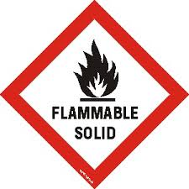
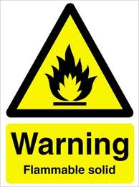
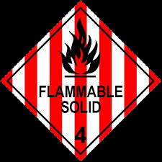
RISK FACTORS-Chemical

Slide 103
RISK FACTORS-Chemical
Spontaneously Combustible

Slide 104
RISK FACTORS-Chemical
Spontaneously Combustible -Spontaneously combustible materials are also known as pyrophoric; these chemicals can spontaneously ignite in the presence of air, some are reactive with water vapor, and most are reactive with oxygen. Two common examples are tert-Butyllithium under Hexanes and White Phosphorus. In addition to the hazard of the spontaneously combustible chemical itself, many of these chemicals are also stored under flammable liquids. In the event of an accident, such as a bottle being knocked off a shelf, the chemical can spontaneously ignite and a fire can occur. Extra care must be taken when handling spontaneously combustible chemicals. When transporting these chemicals, it is best to use a bottle carrier and carts.

Slide 105
RISK FACTORS-Chemical
1.A substance with a relatively low ignition temperature (hay, straw, peat, etc.) begins to release heat. This may occur in several ways, usually oxidation by a little moisture and air, bacterial fermentation generates heat.
2.The heat is unable to escape (hay, straw, peat, etc. are good thermal insulators), and the temperature of the material rises.
3.The temperature of the material rises above its ignition point (even though much of the bacteria are destroyed by ignition temperatures).
4.Combustion begins if sufficient oxidizer, such as oxygen, and fuel are present to maintain the reaction into thermal run-away.

Slide 106
RISK FACTORS-Chemical

Slide 107
Carcinogens

Slide 108
RISK FACTORS-Chemical
Carcinogens-Chemical capable of causing changes in the DNA resulting in uncontrolled growth of cells or cancer. They are insidious because no immediate harmful effects are felt. Latency period can be from 20-30 years
Usually results from chronic exposures
Defined in the Lab Standard as a chemical that is:
Regulated by OSHA as a carcinogen,
It is listed by the National Toxicology Program,
It is listed as a group 1 under IARC (international agency on cancer research),
It is listed as a group 2A, or 2B under IARC probable and possibly carcinogenic to humans.

Slide 109
Substances dangerous when wet

Slide 110
RISK FACTORS-Chemical
Dangerous When Wet-Dangerous when wet compounds react violently with water to form toxic vapors and/or flammable gases that can ignite and cause a fire. Please note, attempting to put out a fire involving dangerous when wet materials with water will only make the situation worse. Special “Class D” fire extinguishers are required for use with dangerous when wet compounds. Common examples include sodium metal and potassium metal.
It is important to note that any paper toweling, gloves, etc., that have come into contact with these materials need to be quenched with water before disposing of in metal trash cans in order to prevent potential fires.
If you are using dangerous when wet compounds and do not have a Class D fire extinguisher present, then please contact services for more assistance.

Slide 111
Oxidizers

Slide 112
RISK FACTORS-Chemical
Oxidizers and Organic Peroxides-The OSHA Laboratory Standard defines an oxidizer as “a chemical other than a blasting agent or explosive that initiates or promotes combustion in other materials, thereby causing fire either of itself or through the release of oxygen or other gases.” Under the DOT hazard class system, oxidizers are listed as hazard class 5.1 and organic peroxides are listed as hazard class 5.2.
The OSHA Laboratory Standard defines an organic peroxide as “an organic compound that contains the bivalent –O-O- structure and which may be considered to be a structural derivative of hydrogen peroxide where one or both of the hydrogen atoms have been replaced by an organic radical.”
Oxidizers and organic peroxides are a concern for laboratory safety due to their ability to promote and enhance the potential for fires in labs

Slide 113
Peroxide Forming Compounds

Slide 114
RISK FACTORS-Chemical
Peroxide Forming Compounds-
Many commonly used chemicals; organic solvents in particular, can form shock, heat, or friction sensitive peroxides upon exposure to oxygen. Once peroxides have formed, an explosion can result during routine handling, such as twisting the cap off a bottle – if peroxides are formed in the threads of the cap. Explosions are more likely when concentrating, evaporating, or distilling these compounds if they contain peroxides. When these compounds are improperly handled and stored, a serious fire and explosion hazard exists.

Slide 115
RISK FACTORS-Chemical
Poisons

Slide 116
RISK FACTORS-Chemical
Poisons -For the purpose of this manual the word “Poison” will be used interchangeably with the word “Toxic”. OSHA defines “Toxic” as a chemical falling within any of the following categories:
A chemical that has a median lethal dose (LD50) of more than 50 milligrams per kilogram, but not more than 500 milligrams per kilogram of body weight when administered orally to albino rats weighing between 200 and 300 grams each.
A chemical that has a median lethal dose (LD50) of more than 200 milligrams per kilogram, but not more than 1000 milligrams per kilogram of body weight when administered by continuous contact for 24 hours (or less if death occurs within 24 hours) with the bare skin of albino rabbits weighing between two and three kilograms each.
A chemical that has a median lethal concentration (LC50) in air of more than 200 parts per million, but not more than 2000 parts per million by volume of gas or vapor, or more than two milligrams per liter but not more than 20 milligrams per liter of mist, fume, dust, when administered by continuous inhalation for one hour (or less if death occurs with in one hour) to albino rats weighing between 200 and 300 grams each.

Slide 117
RISK FACTORS-Chemical
Corrosives

Slide 118
RISK FACTORS-Chemical
Corrosives-OSHA defines a corrosive as “a chemical that causes visible destruction of, or irreversible alterations in living tissue by chemical action at the site of contact.” Under the DOT hazard class system, corrosives are listed as hazard class 8.
Corrosive chemicals can be further subdivided as acids and bases. Corrosives can be in the liquid, solid, or gaseous state. Corrosive chemicals can have a severe effect on eyes, skin, respiratory tract, and gastrointestinal tract if an exposure occurs. Corrosive solids and their dusts can react with moisture on the skin or in the respiratory tract and result in an exposure.
Whenever working with concentrated corrosive solutions, splash goggles should be worn instead of safety glasses. Splash goggles used in conjunction with a face shield provides better protection. Please note that a face shield alone does not provide adequate protection. Use of rubber gloves such as butyl rubber and a rubber apron may also be required.
Corrosive chemicals should be handled in a fume hood to avoid breathing corrosive vapors and gases.

Slide 119
RISK FACTORS-Chemical
Hydrofluoric Acid

Slide 120
RISK FACTORS-Chemical
Hydrofluoric Acid -Hydrofluoric Acid (HF) is one of the most hazardous chemicals. Small exposures to HF can be fatal if not treated properly. The critical minutes immediately after an exposure can have a great effect on the chances of a victim’s survival.
HF is a gas that is dissolved in water to form Hydrofluoric acid. The concentration can vary from very low such as in store bought products up to the most concentrated 70% form (anhydrous), with the most common lab use around 48%. The liquid is colorless, non-flammable and has a pungent odor. The OSHA permissible exposure limit is 3 ppm, but concentrations should be kept as low as possible. HF is actually a weak acid by definition and not as corrosive as strong acids such as Hydrochloric (HCl), however, corrosivity is the least hazardous aspect of HF. The toxicity of HF is the main concern.
HF is absorbed through the skin quickly and is a severe systemic toxin. The fluoride ion binds calcium in the blood, bones and other organs and causes damage to tissues that is very painful and can be lethal. At the emergency room, the victim is often given calcium injections, but pain medication is not generally given since the pain subsiding is the only indication that the calcium injections are working.

Slide 121
RISK FACTORS-Chemical
Perchloric Acid

Slide 122
RISK FACTORS-Chemical
Perchloric Acid-Perchloric acid is a strong oxidizing acid that can react violently with organic materials. Perchloric acid can also explode if concentrated above 72%. For any work involving heated Perchloric acid (such as in Perchloric acid digestions), the work must be conducted in a special Perchloric acid fume hood with a wash down function. If heated Perchloric acid is used in a standard fume hood, the hot Perchloric acid vapors can react with the metal in the hood ductwork to form shock sensitive metallic perchlorates. When working with Perchloric acid, be sure to remove all organic materials, such as solvents, from the immediate work area. Due to the potential danger of Perchloric acid, if possible, try to use alternate techniques that do not involve the use of Perchloric acid. If you must use Perchloric acid in your experiments, only purchase the smallest size container necessary. Because Perchloric acid is so reactive, it is important to keep it stored separate from other chemicals, particularly organic solvents, organic acids, and oxidizers. All containers of Perchloric acid should be inspected regularly for container integrity and the acid should be checked for discoloration. Discolored Perchloric acid should be discarded as hazardous waste. Perchloric acid should be used and stored away from combustible materials, and away from wooden furniture. Like all acids, but particularly with Perchloric acid, secondary containment should be used for storage.

Slide 123
RISK FACTORS-Chemical
Reproductive Toxins

Slide 124
RISK FACTORS-Chemical
Reproductive Toxins -The OSHA Lab Standard defines a reproductive toxin as a chemical “which affects the reproductive capabilities including chromosomal damage (mutations) and effects on fetuses (teratogens)”. A number of reproductive toxins are chronic toxins that cause damage after repeated or long duration exposures and can have long latency periods. Women of childbearing potential should be especially careful when handling reproductive toxins. Pregnant women and women intending to become pregnant, or men seeking to have children, should seek the advice of their physician before working with known or suspected reproductive toxins.

Slide 125
Acute Toxins

Slide 126
RISK FACTORS-Chemical
Acute Toxins -
OSHA defines a chemical as being highly toxic if it falls within any of the following categories:
(a) A chemical that has a median lethal dose (LD50) of 50 milligrams or less per kilogram of body weight when administered orally to albino rats weighing between 200 and 300 grams each.
(b) A chemical that has a median lethal dose (LD50) of 200 milligrams or less per kilogram of body weight when administered by continuous contact for 24 hours (or less if death occurs within 24 hours) with the bare skin of albino rabbits weighing between two and three kilograms each.
(c) A chemical that has a median lethal concentration (LC50) in air of 200 parts per million by volume or less of gas or vapor, or 2 milligrams per liter or less of mist, fume, or dust, when administered by continuous inhalation for one hour (or less if death occurs within one hour) to albino rats weighing between 200 and 300 grams each.

Slide 127
RISK FACTORS-Chemical
Acute Toxins –are including:acrolein, arsine,chlorine, diborane, diazomethane, hydrogen cyanide, hydrogen floride, sodium cyanide, etc.

Slide 128
Oxidizers

Slide 129
RISK FACTORS-Chemical
Oxidizers ,, organic peroxides and other substances and products are a concern for laboratory safety due to their ability to promote and enhance the potential for fires in labs.
As a reminder of the fire triangle (now referred to as the fire tetrahedron), in order to have a fire, you need:
A fuel source.
An oxygen source.
An ignition source.
A chemical reaction.
Oxidizers can supply the oxygen needed for the fire, whereas organic peroxides supply both the oxygen and the fuel source. Both oxidizers and organic peroxides may become shock sensitive when they dry out, are stored in sunlight, or due to contamination with other materials, particularly when contaminated with heavy metals. Most organic peroxides are also temperature sensitive.

Slide 130
RISK FACTORS-Chemical
Establishment of a Designated Area-
For work involving particularly hazardous substances, laboratories should establish a designated area where particularly hazardous substances can only be used. In some cases, a designated area could be an entire room out of a suite of rooms, or could mean one particular fume hood within a laboratory. The idea is to designate one area that everyone in the laboratory is aware of where the particularly hazardous substances can only be used.
In certain cases of establishing designated areas, laboratory supervisors may want to restrict use of a particularly hazardous substance to a fume hood, glove box or other containment device. This information should be included as part of the laboratory’s SOPs and covered during in-lab training.
Establishing a designated area not only provides better employee protection, but can help minimize the area where potential contamination of particularly hazardous substances could occur. If a designated area is established, a sign should be hung up (on a fume hood for example) indicating the area is designated for use with particularly hazardous substances. Most designated areas will have special PPE requirements and/or special waste and spill cleanup procedures as well. These and other special precautions should be included within the lab’s SOPs.

Slide 131
RISK FACTORS-Chemical
Safe Removal of Contaminated Materials and Waste-Some particularly hazardous substances may require special procedures for safe disposal of both waste and/or contaminated materials. When in doubt, contact specialized teams to determine proper disposal procedures. Once these disposal procedures have been identified, they should be included as part of the laboratory’s SOPs and everyone working in the lab should be trained on those procedures.

Slide 132
RISK FACTORS-Chemical
Decontamination Procedures -
Some particularly hazardous substances may require special decontamination or deactivation procedures (such as Diaminobenzidine waste or Ethidium bromide) for safe handling. Review MSDSs and other reference materials when working with particularly hazardous substances to identify is special decontamination procedures are required. If they are required, then this information should be included in the laboratory’s SOPs and appropriate training needs to be provided to laboratory personnel who work with these chemicals.

Slide 133
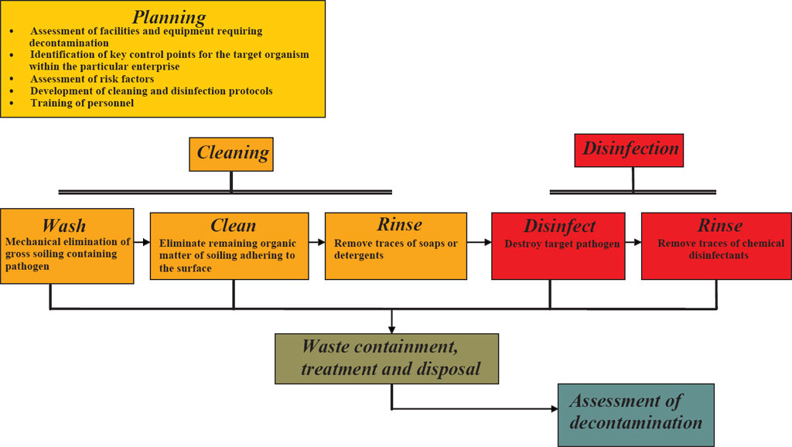
RISK FACTORS-Chemical
Decontamination Procedures – schema for decontamination

Slide 134
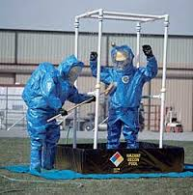
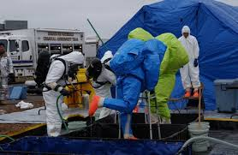
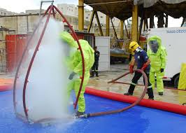
RISK FACTORS-Chemical
Decontamination Procedures -examples

Slide 135
Psychosocial RISK FACTORS

Slide 136
RISK FACTORS-Psychosocial
Employers in most OECD countries have an obligation not only to protect the physical health of their employees but also the psychological health. Therefore as part of a risk management framework psychological or psychosocial hazards (risk factors) need to be identified and controlled for in the workplace. Psychosocial risk factors are related to the way work is designed, organized and managed, as well as the economic and social contexts of work and are associated with psychiatric, psychological and/or physical injury or illness. Linked to psychosocial risks are issues such as occupational stress and workplace violence which are recognized internationally as major challenges to occupational health and safety.

Slide 137
RISK FACTORS-Psychosocial
According to a survey by the European Agency for Safety and Health at Work, the most important emerging psychosocial risks are:
Precarious work contracts
Increased worker vulnerability due to globalization
New forms of employment contracts
Feeling of job insecurity
Aging workforce
Long working hours
Work intensification
Lean production and outsourcing
High emotional demands
Poor work-life balancee

Slide 138
RISK FACTORS-in Constructions
Construction is one of the most dangerous occupations in the world, incurring more occupational fatalities than any other sector in both the United States and in the European Union. Construction workers are exposed to mechanical and electrical risk factors, could be exposed also to biological risk factors- as they are generally working outdoors and possibly to chemical risk factors due to all the cement dust, paints, etc.Falls are one of the most common causes of fatal and non-fatal injuries among construction workers. Proper safety equipment such as harnesses and guardrails and procedures such as securing ladders and inspecting scaffolding can curtail the risk of occupational injuries in the construction industry. Due to the fact that accidents may have disastrous consequences for employees as well as organizations, it is of utmost importance to ensure health and safety of workers and compliance with national construction requirements.

Slide 139
RISK FACTORS-in Agriculture
Agriculture workers are often at risk of work-related injuries, lung disease, noise-induced hearing loss, skin disease, as well as certain cancers related to chemical use or prolonged sun exposure. Physical fatigue is one of the most common risk factors- considering the long hours spend outside doing hard work.On industrialized farms, injuries frequently involve the use of agricultural machinery. The most common cause of fatal agricultural injuries in the United States is tractor rollovers, which can be prevented by the use of roll over protection structures which limit the risk of injury in case a tractor rolls over. Pesticides and other chemicals used in farming can also be hazardous to worker health, and workers exposed to pesticides may experience illnesses or birth defects. As an industry in which families, including children, commonly work alongside their families, agriculture is a common source of occupational injuries and illnesses among younger workers. Common causes of fatal injuries among young farm worker include drowning, machinery and motor vehicle-related accidents.
Studies done in 2010 found elevated prevalence rates of several occupational exposures in the agriculture, forestry, and fishing sector which may negatively impact health. These workers often worked long hours. The prevalence rate of working more than 48 hours a week among workers employed in these industries was 37%, and 24% worked more than 60 hours a week. Of all workers in these industries, 85% frequently worked outdoors compared to 25% of all U.S. workers.

Slide 140
RISK FACTORS-in Extractive Industries
Workers employed in mining and oil & gas extraction industries had high prevalence rates of exposure to potentially harmful work organization characteristics and hazardous chemicals.They are also exposed to dust and micro-particles derived from their specific work- gaining specific occupational diseases. Many of these workers worked long hours: 50% worked more than 48 hours a week and 25% worked more than 60 hours a week in 2010. Additionally, 42% worked non-standard shifts (not a regular day shift). These workers also had high prevalence of exposure to physical/chemical hazards. In 2010, 39% had frequent skin contact with chemicals. Among nonsmoking workers, 28% of those in mining and oil and gas extraction industries had frequent exposure to secondhand smoke at work. About two-thirds were frequently exposed to vapors, gas, dust, or fumes at work.

Slide 141
RISK FACTORS-in the Services
As the number of service sector jobs has risen in developed countries, more and more jobs have become sedentary, presenting a different array of health problems than those associated with manufacturing and the primary sector. Contemporary problems such as the growing rate of obesity and issues relating to occupational stress, workplace bullying, and overwork in many countries have further complicated the interaction between work and health.
The employees in the service sector are exposed to mechanical and chemical hazards. They could be also exposed to chemical hazards if they are working in activity such clothes cleaning, indoor cleaning, insulating, etc.
According to data from the 2010 NHIS-OHS, hazardous physical/chemical exposures in the service sector were lower than national averages. On the other hand, potentially harmful work organization characteristics and psychosocial workplace exposures were relatively common in this sector. Among all workers in the service industry, 30% experienced job insecurity in 2010, 27% worked non-standard shifts (not a regular day shift), 21% had non-standard work arrangements (were not regular permanent employees)

Slide 142
RISK FACTORS-in Healthcare
Healthcare workers are exposed to many hazards that can adversely affect their health and well-being. Long hours, changing shifts, physically demanding tasks, violence, and exposures to infectious diseases and harmful chemicals are examples of hazards that put these workers at risk for illness and injury.
U.S. hospitals recorded 253,700 work-related injuries and illnesses in 2011, which is 6.8 work-related injuries and illnesses for every 100 full-time employees. The injury and illness rate in hospitals is higher than the rates in construction and manufacturing – two industries that are traditionally thought to be relatively hazardous.
OHSN modules currently focus on three high risk and preventable events that can lead to injuries or musculoskeletal disorders among healthcare personnel: musculoskeletal injuries from patient handling activities; slips, trips, and falls; and workplace violence.

Slide 143
CONCLUSIONS
Risk factors must be:
1.known. An unknown risk factor could lead to a massive accident that has no way to be stopped or mitigated; So, the first thing in the prevention of risk at workplace would be the identification of risk factors at the workplace;

Slide 144
CONCLUSIONS
Risk factors must be:
2.understood in the activity context. You could be exposed to an earthquake risk- if you are living in such an area- but there are more important risk factors at the workplace. The auditor should evaluate:
The possible effect of the risk factors upon significant material assets at the workplace- that is showing us the loss aspect of risk;
The possible effect of risk factors upon persons (employees and other staff) at the workplace- that gives incidents and occupational accidents;

Slide 145
CONCLUSIONS
Risk factors must be:
3. given quantification measures using the experience of the auditor and also statistical data. Probability of apparition of a specific risk factor should be correlated with specific historic data from the workplace- as there are never two identical workplaces. In evaluating the gravity of a specific risk factor, beyond the experience statistical data is usable. Exposure to risk should be evaluated properly.

Slide 146
CONCLUSIONS
Risk factors must be:
4. seen in a joint action. There are few cases in which there is only one risk factor acting. Scenarios involving joint action of risk could be developed and used in order to assure a proper prevention- when this is feasible. On the other part, in most enterprises – the most significant risk factors are treated at first.

Slide 147
CONCLUSIONS
It is better to take care now. Even if the identified risk factors are not extremely dangerous now, prevention is needed in order to assure a safe workplace on mid and long term.
Employees should be informed about the risk factors at the workplace, without making them scarry. A safety enterprise has everywhere risk reduced beyond the ALARP level.
Employees should be trained concerning the existing and also the new and emergent risk factors.

